Slide 1
Beta regression
Michail Belias
Department for Health Evidence

Slide 2
How would one perform an analysis with a bounded dependent variable?
Y $∈($a, b) or Y $∈($0, 1)
Y ∈(a, b) or Y ∈(0, 1)
Transform the data
$\tilde{Y}= g(Y)$ ~ $\tilde{Y}$ $∈$ S ⊆ ℝ
Transform the data
𝑌 ̃= 𝑔(𝑌) ~ 𝑌 ̃ ∈ S ⊆ ℝ
logit transformation
Arcsine-square root transformation

Slide 3
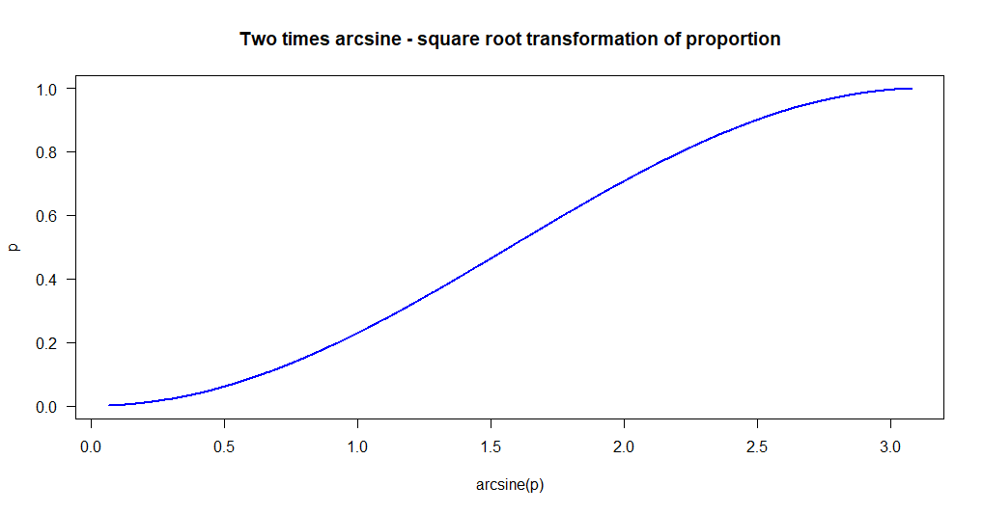
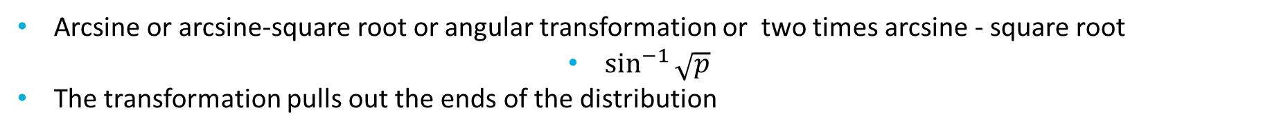
Arcsine-square root transformation
Arcsine or arcsine-square root or angular transformation or two times arcsine - square root
$\sin^{−1}{\sqrt{p}}$
The transformation pulls out the ends of the distribution

Slide 4
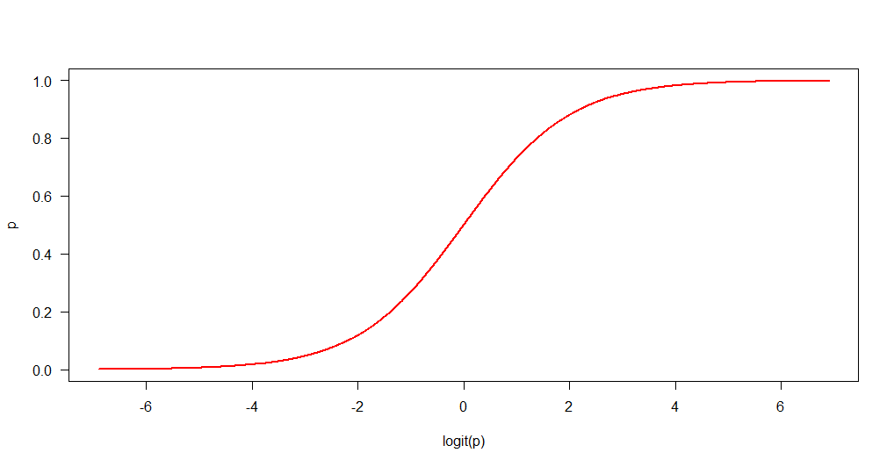
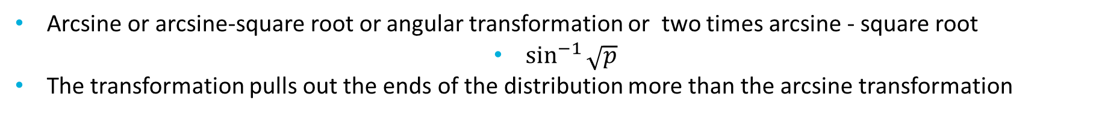
logit transformation
Arcsine or arcsine-square root or angular transformation or two times arcsine - square root
$\sin^{−1}{\sqrt{p}}$
The transformation pulls out the ends of the distribution more than the arcsine transformation

Slide 5
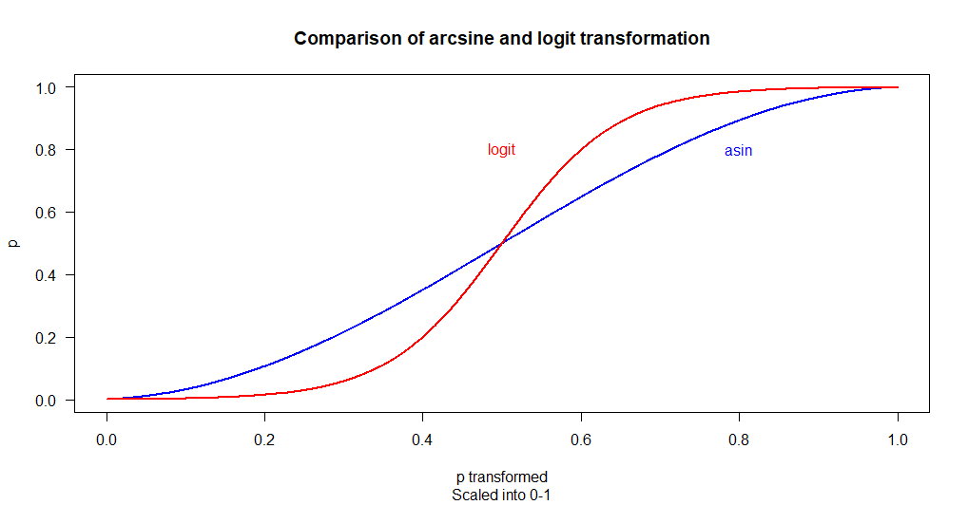
Comparison of effects
The difference in the effect of the transformation is better shown on the same scale

Slide 6
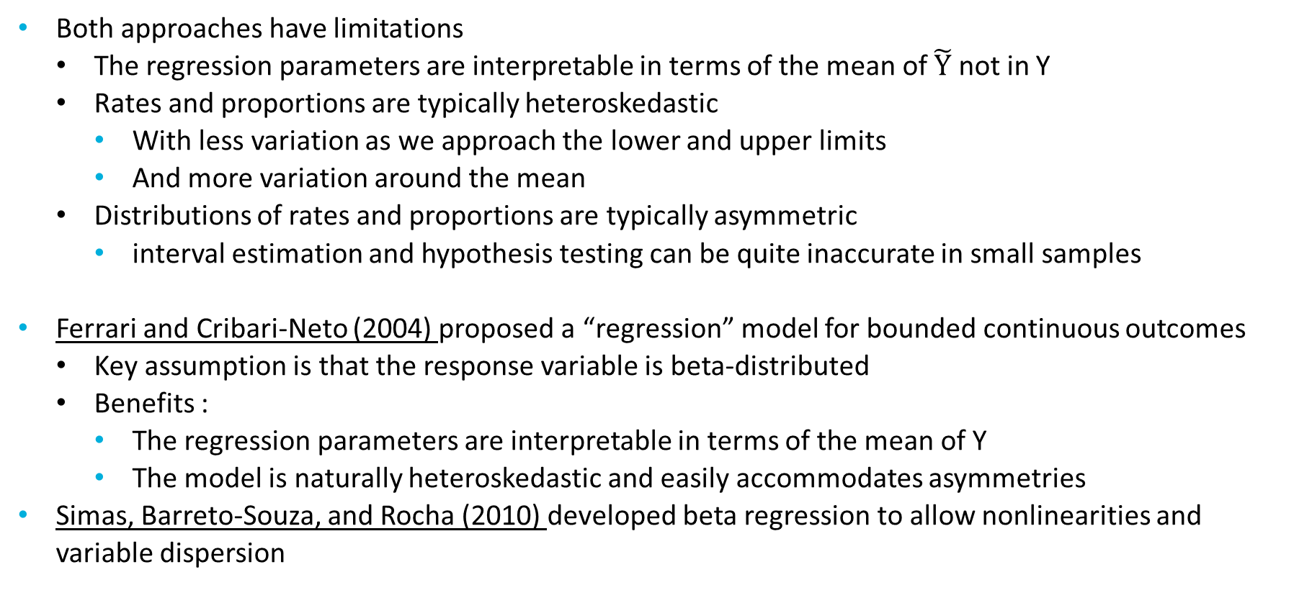
Different point of view
Both approaches have limitations
The regression parameters are interpretable in terms of the mean of $\tilde{Y}$ not in Y
Rates and proportions are typically heteroskedastic
With less variation as we approach the lower and upper limits
And more variation around the mean
Distributions of rates and proportions are typically asymmetric
interval estimation and hypothesis testing can be quite inaccurate in small samples
Ferrari and Cribari-Neto (2004) proposed a “regression” model for bounded continuous outcomes
Key assumption is that the response variable is beta-distributed
Benefits :
The regression parameters are interpretable in terms of the mean of Y
The model is naturally heteroskedastic and easily accommodates asymmetries
Simas, Barreto-Souza, and Rocha (2010) developed beta regression to allow nonlinearities and variable dispersion

Slide 7
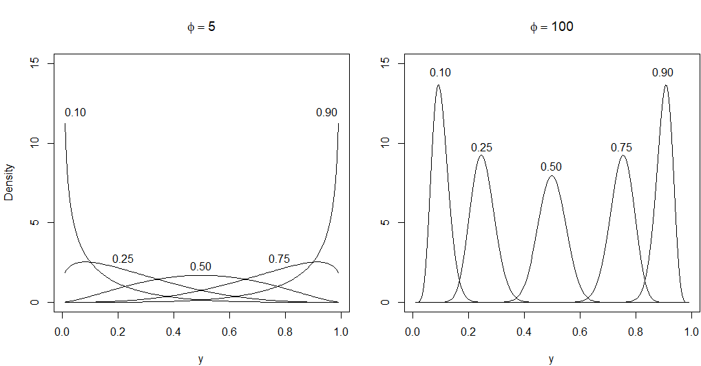
Beta distribution
Probability density functions for beta distributions with varying parameters

Slide 8
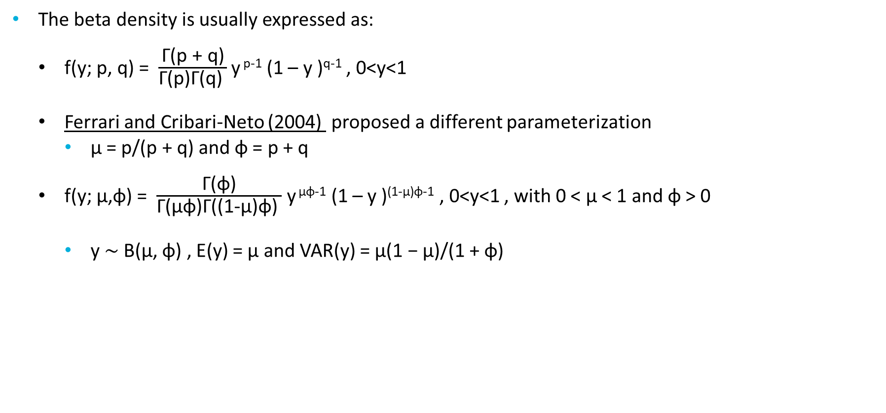
Beta regression models
The beta density is usually expressed as:
f(y; p, q) = $\frac{\text{Γ}\text{(}\text{p}\text{ + }\text{q}\text{)}}{\text{Γ}\text{(}\text{p}\text{)}\text{Γ}\text{(}\text{q}\text{) }}$ y ^{p-1} (1 – y )^{q-1} , 0<y<1
Ferrari and Cribari-Neto (2004) proposed a different parameterization
µ = p/(p + q) and φ = p + q
f(y; μ,φ) = $\frac{\text{Γ}\text{(}\text{φ}\text{)}}{\text{Γ}\text{(}\text{μφ}\text{)}\text{Γ}\text{(}\text{(1-}\text{μ}\text{)}\text{φ}\text{) }}$ y ^{μφ-1} (1 – y )^{(1-μ)φ-1} , 0<y<1 , with 0 < µ < 1 and φ > 0
y ∼ B(µ, φ) , E(y) = µ and VAR(y) = µ(1 − µ)/(1 + φ)

Slide 10
References
[1] Silvia Ferrari & Francisco Cribari-Neto (2010) Beta Regression for Modelling Rates and Proportions, Journal of Applied Statistics, 31:7, 799-815, DOI: 10.1080/0266476042000214501
[2] Simas, Alexandre & Barreto-Souza, Wagner & V. Rocha, Andréa. (2010). Improved estimators for a general class of beta regression models. Computational Statistics & Data Analysis. 54. 348-366. 10.1016/j.csda.2009.08.017.

